Slide 1

Tamás Papp
Sr. Software Engineer
t03apt@gmail.com
LinkedIn: t03apt

Slide 2
Agenda
Azure Storage
Azure Blob, Queues, Tables
Azure SQL Server

Slide 3

Azure Storage

Slide 4
Azure Storage services
Azure Files
Azure Disks
Azure Blobs
Azure Queues
Azure Tables

Slide 5
Azure Storage services
Durable and highly available
Secure
Scalable
Managed
Accessible

Slide 6
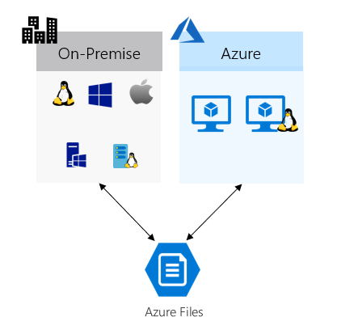
Azure Files
Cloud file share
Supports standard Server Message Block (SMB) protocol or Network File System (NFS) protocol

Slide 7
When to use Azure Files?
“Lift and shift" an application to the cloud
You want to replace or supplement on-premises file servers or NAS devices
You want to store development and debugging tools that need to be accessed from many virtual machines

Slide 8
Azure Disks
Allows data to be persistently stored and accessed from an attached virtual hard disk
An Azure managed disk is a virtual hard disk (VHD)
It is an abstraction over page blobs, blob containers, and Azure storage accounts

Slide 9
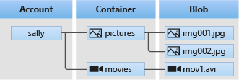
Azure Blobs
Unstructured data store
Supports Azure Data Lake Storage Gen2 for enterprise big data analytics solutions

Slide 10
When to use Azure Blobs?
Streaming and random access scenarios
Access application data from anywhere
Build an enterprise data lake on Azure and perform big data analytics

Slide 11
Cost
Access tiers: Hot, Cool, Archive
Storage capacity costs
Depends on the amount of data stored, the cost varies depending on the access tier
Data access costs
Data access charges increase as the tier gets cooler
Transaction costs
Geo-replication data transfer costs
Geo-replication data transfer incurs a per-gigabyte charge.
Outbound data transfer costs

Slide 12
Azure Queues
Asynchronous message queueing between application components
Some other messaging services in Azure
*Service Bus
Event Hub
*Event Grid

Slide 13
Azure Queues vs Service Bus
Azure Queues
If you require basic communication and messaging between services
One queue can be larger than 80 GB in size (max: 500 TB)
Service Bus provides many advanced features such as
Sessions: First-In-First-Out ordering guarantee
Transactions
Duplicate detection
Automatic dead-lettering
Durable publish and subscribe capabilities

Slide 14
Azure Tables
Store structured NoSQL data in the cloud, providing a key/attribute store with a schemaless design
Storing TBs of structured data capable of serving web scale applications
Storing datasets that don't require complex joins, foreign keys, or stored procedures and can be denormalized for fast access
Quickly querying data using a clustered index
Accessing data using the OData protocol and LINQ queries with WCF Data Service .NET Libraries

Slide 15
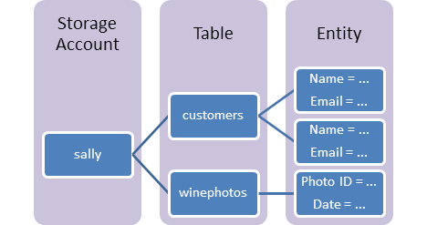
Table storage concepts
Entity
Max. 1 MB
252 properties
System Properties
PartitionKey
RowKey
Timestamp
There are no indexes other than that on the clustered index on the PartitionKey and RowKey!

Slide 16
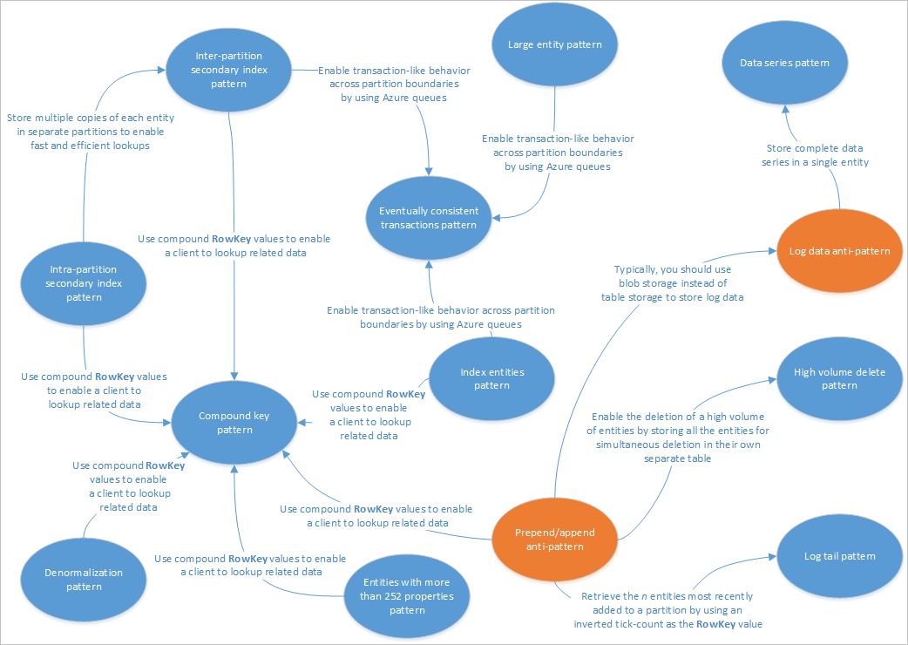
https://docs.microsoft.com/en-us/azure/storage/tables/table-storage-design-patterns

Slide 17
Storage account
Redundancy
Redundancy in the primary region
Locally redundant storage (LRS)
Zone-redundant storage (ZRS)
Microsoft recommends using ZRS in the primary region, and replicating to a secondary region

Slide 18
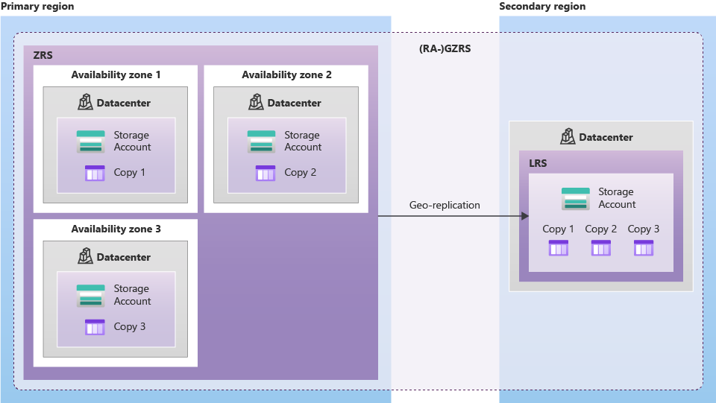

Slide 19
Storage account
Pricing https://azure.microsoft.com/en-us/pricing/details/storage/blobs/

Slide 20
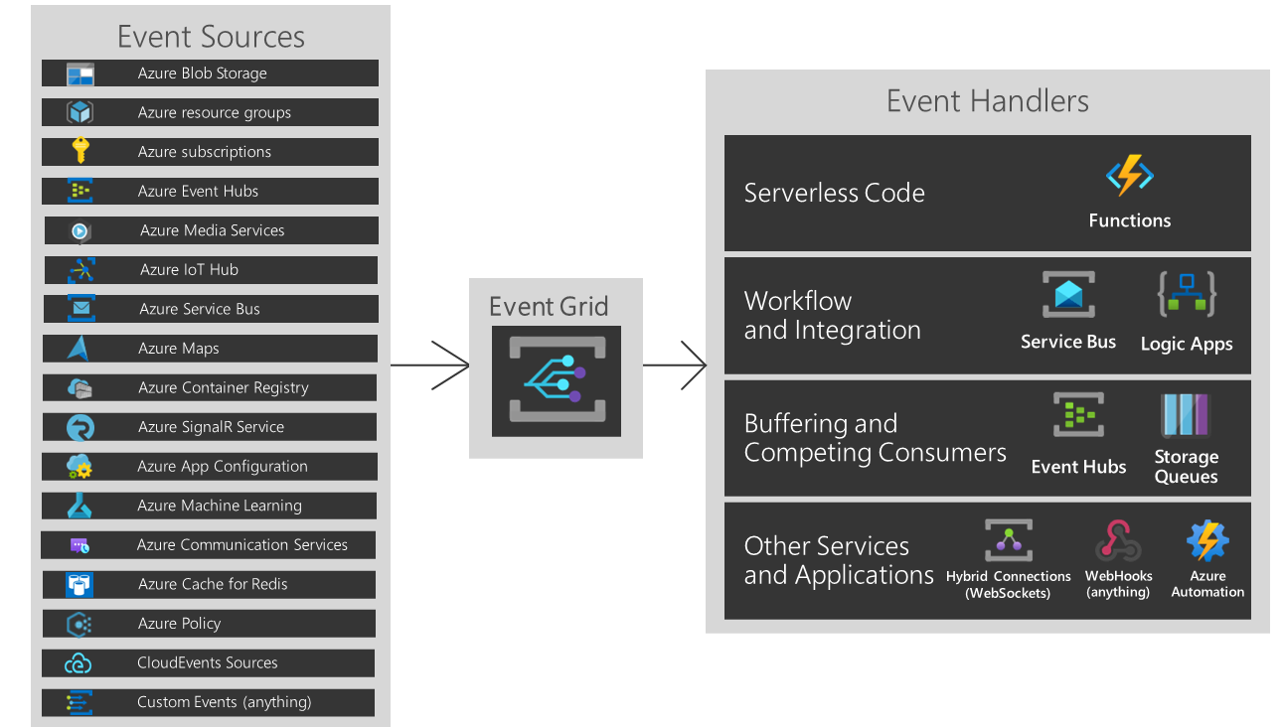
Azure Event Grid

Slide 21
Demo

Slide 22
Azure SQL Server

Slide 23
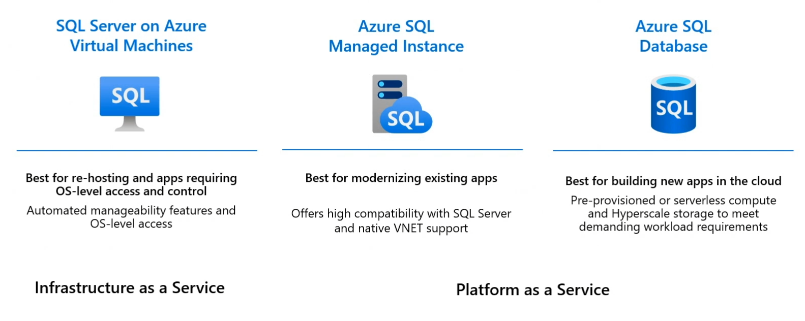

Slide 24
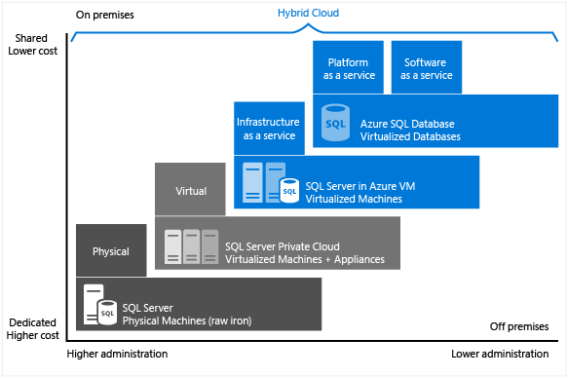

Slide 25
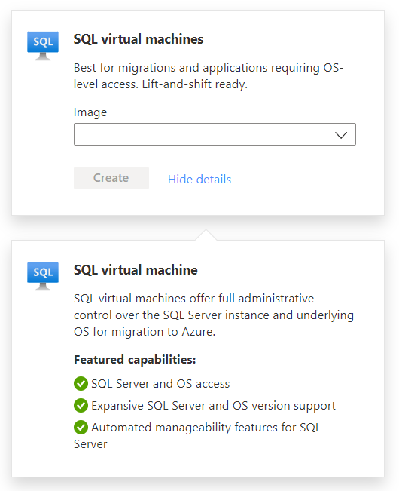

Slide 26
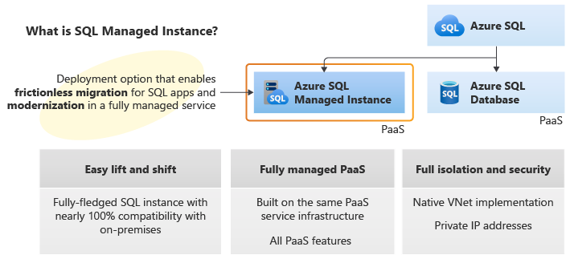

Slide 27
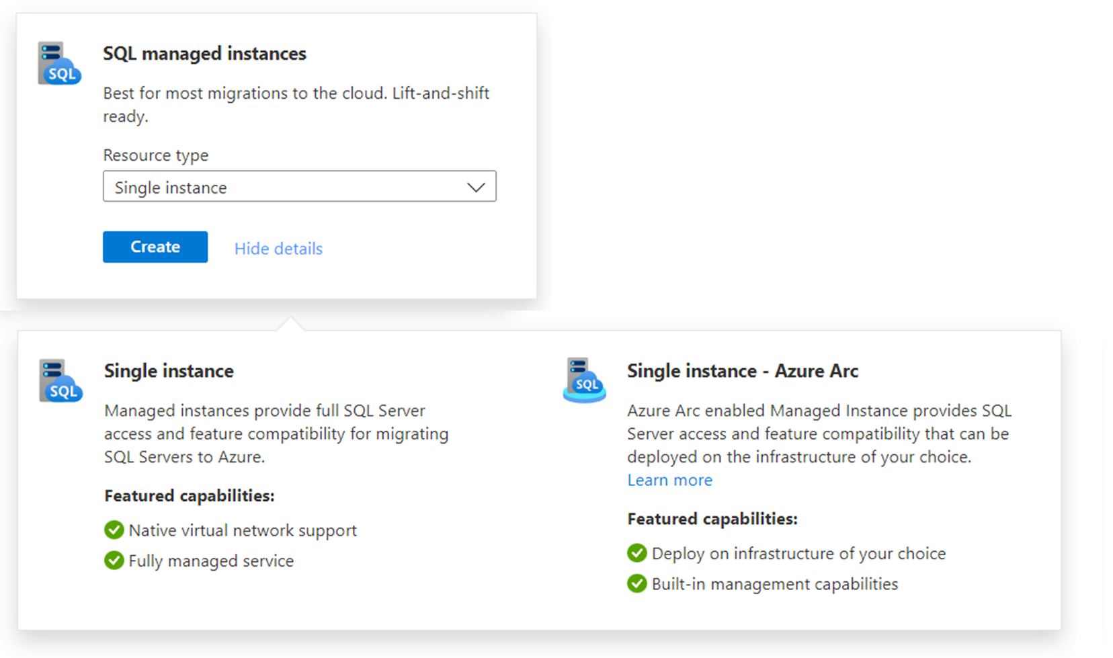

Slide 28
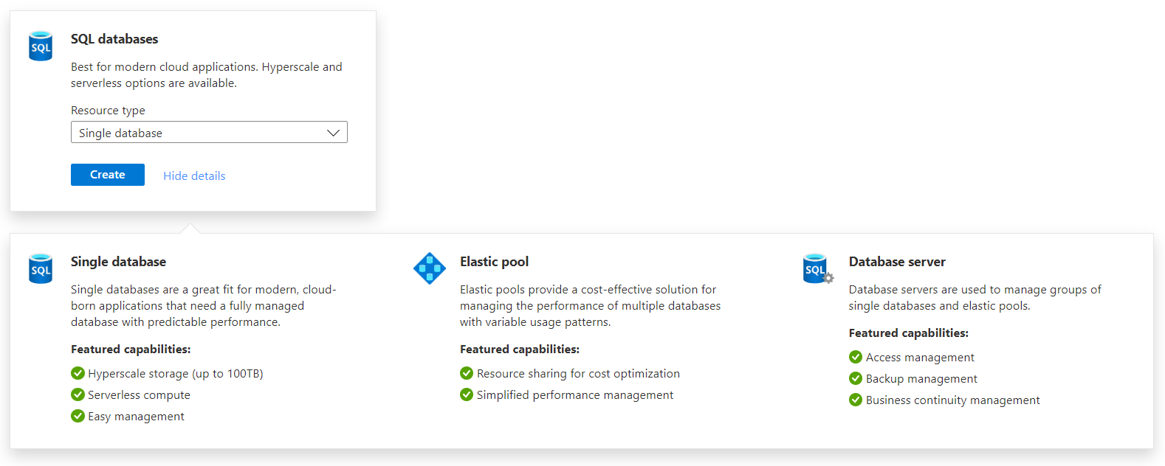

Slide 29
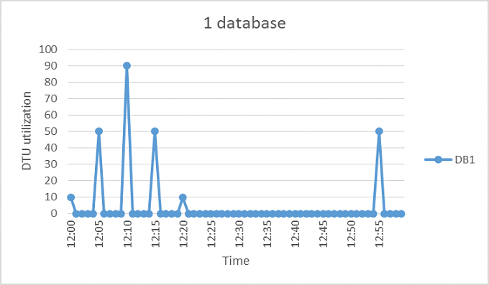
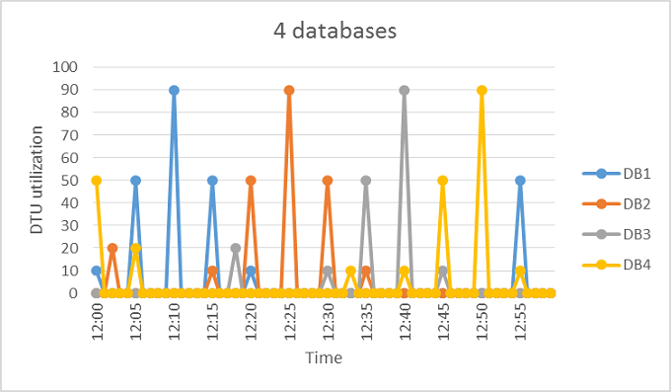
Elastic pool

Slide 30
Azure SQL Server
Logical construct
Administrative point for a collection of databases
At the server level, you can administer
Logins
Firewall rules
Auditing rules
Threat detection policies
Auto-failover groups

Slide 31
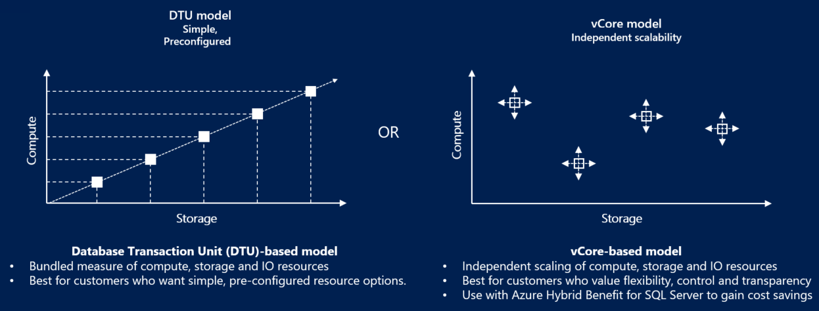
Purchasing models

Slide 32
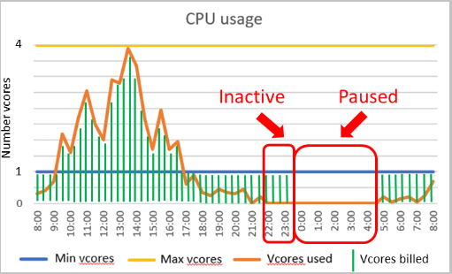
Serverless compute tier

Slide 33
Hyperscale service tier
Support for up to 100 TB of database size
Nearly instantaneous database backups
Fast database restores
Higher overall performance due to higher transaction log throughput
Rapid scale out
Rapid scale up

Slide 34
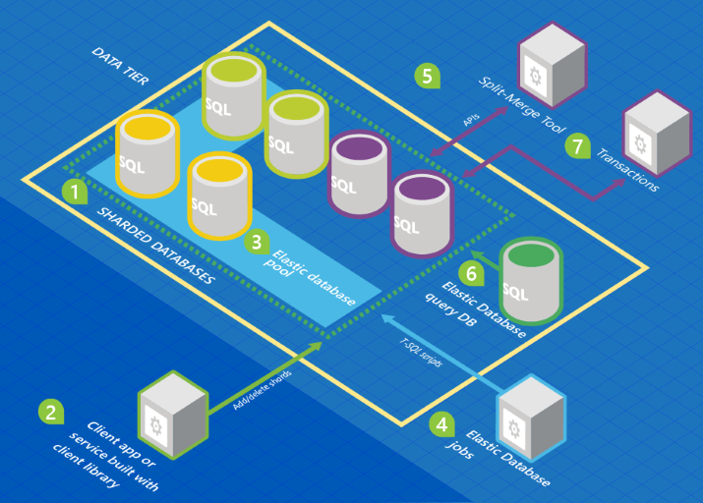
Database sharding

Slide 35
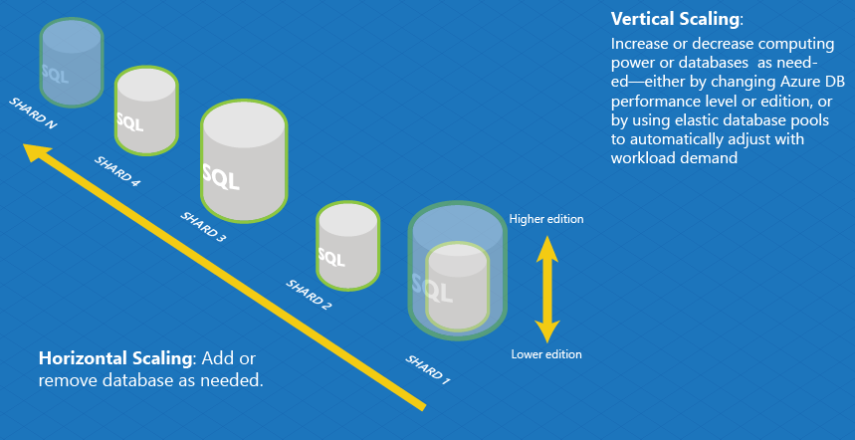

Slide 36
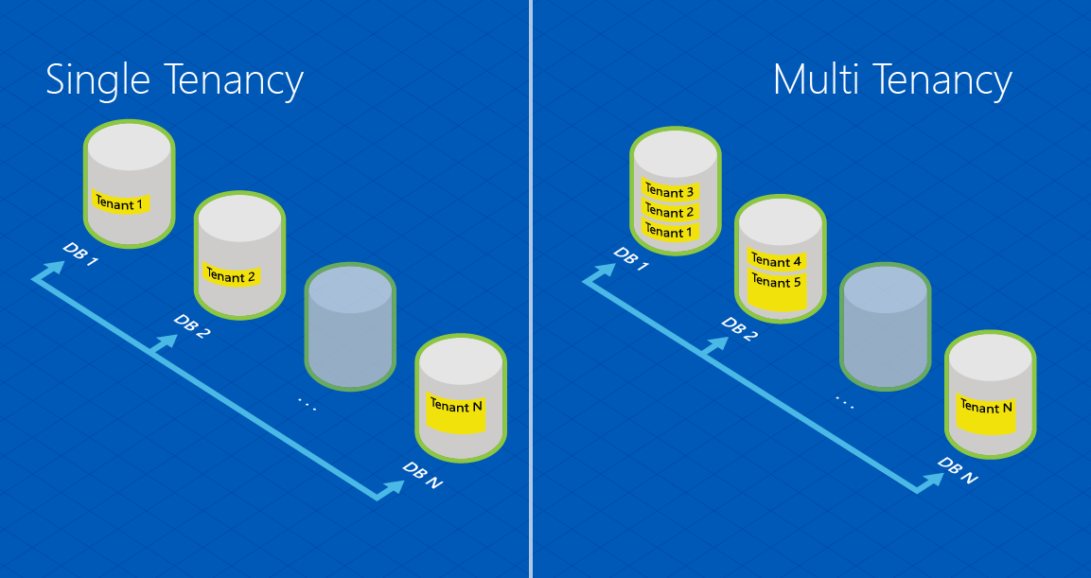

Slide 37
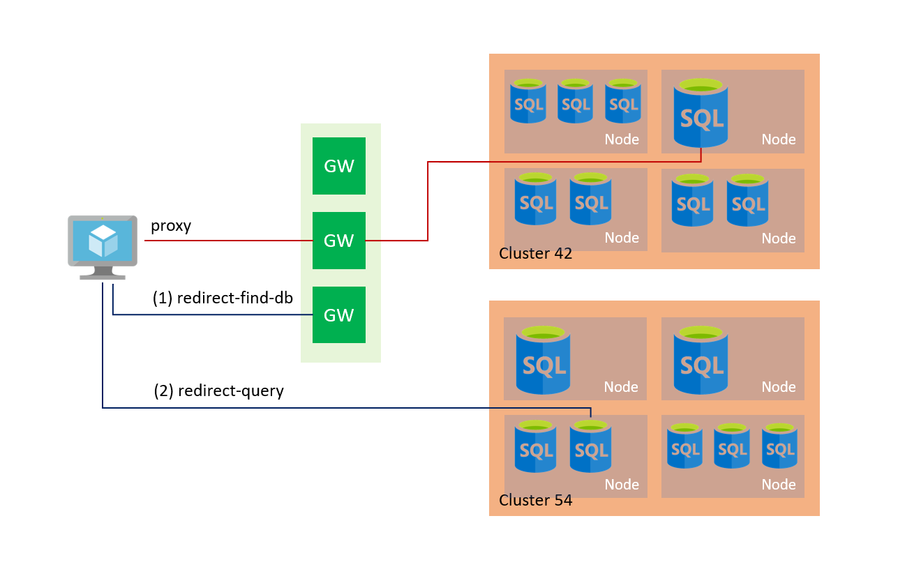
Connectivity architecture

Slide 38
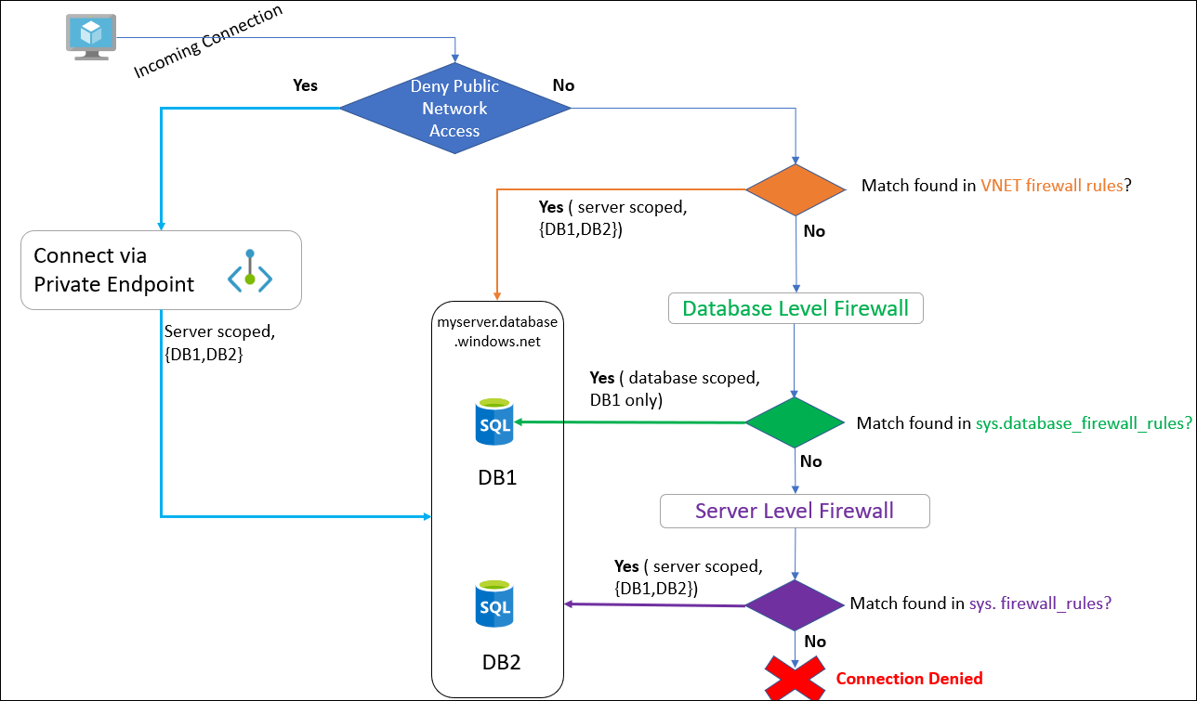
Connectivity settings

Slide 39
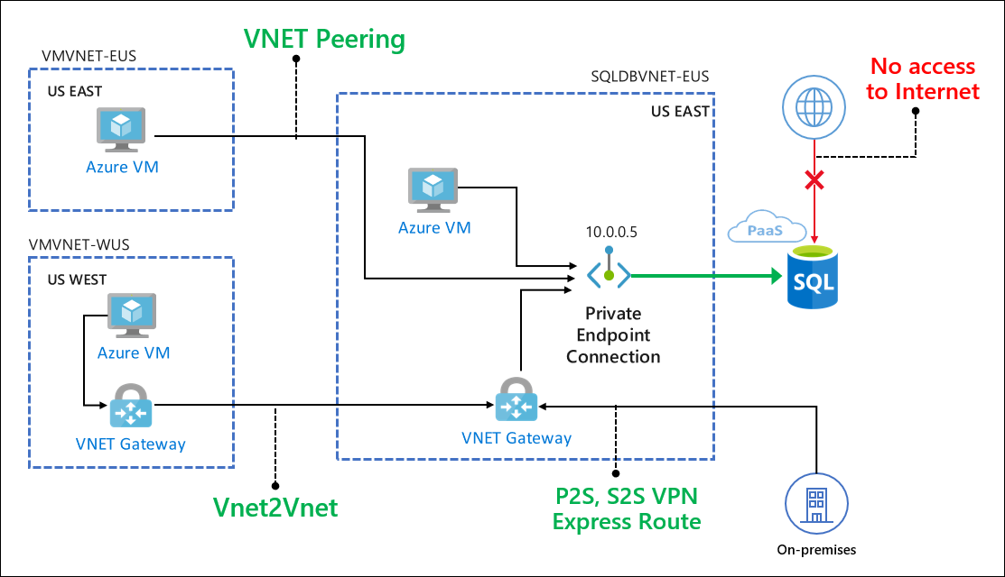

Slide 40
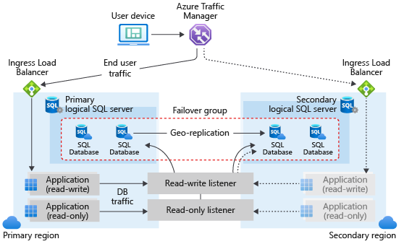
Business continuity

Slide 41
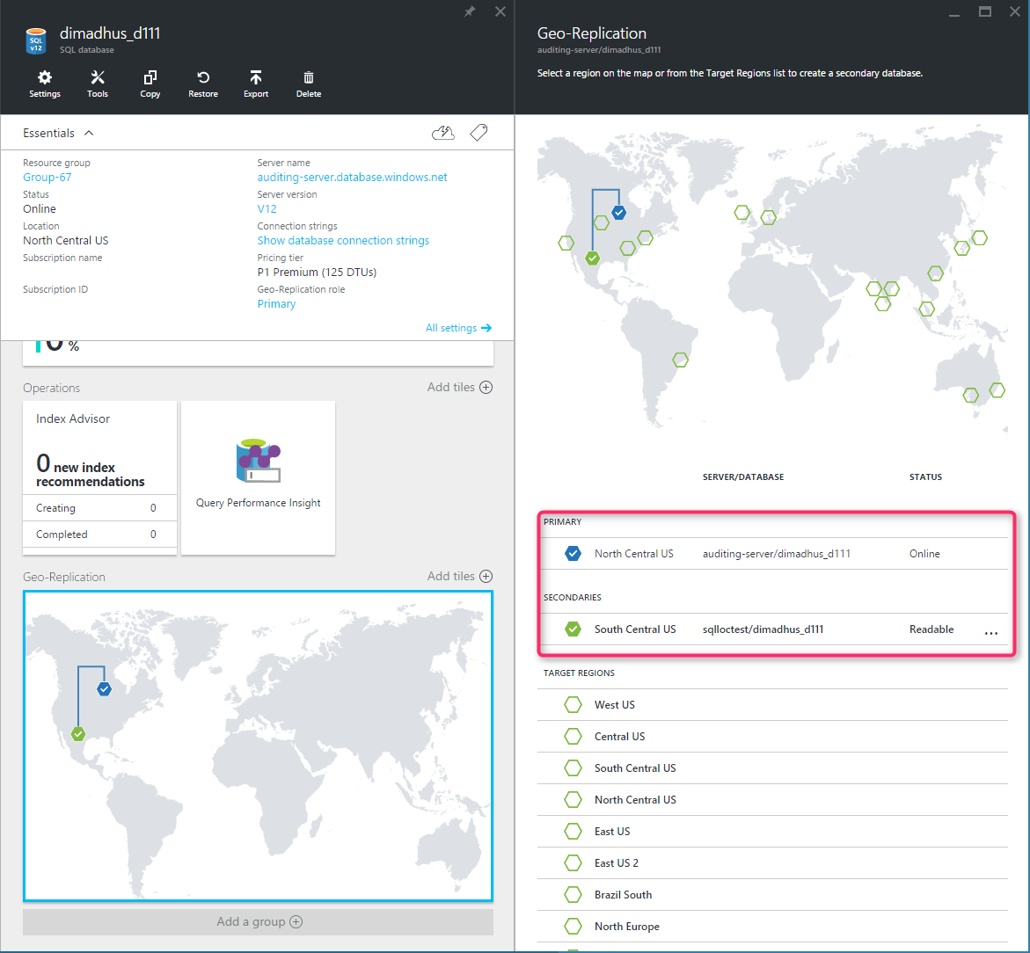

Slide 42
Deployment demo
Azure Portal
Azure CLI
Azure Resource Manager template

Slide 43
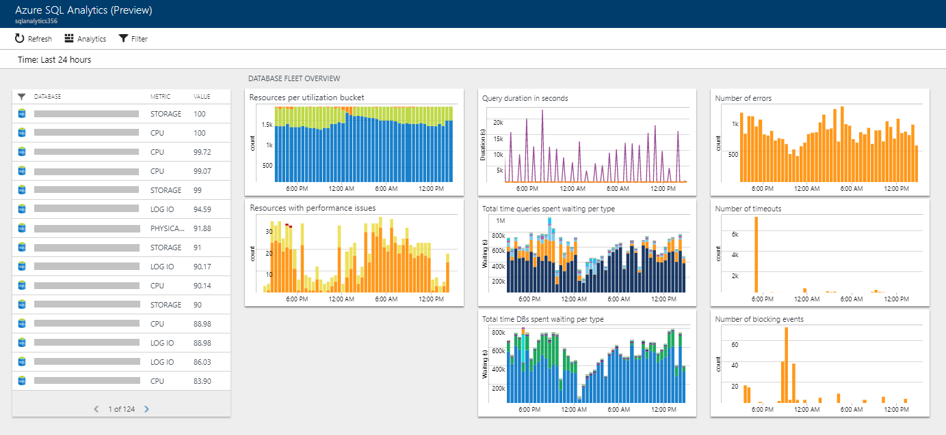
Monitoring

Slide 44
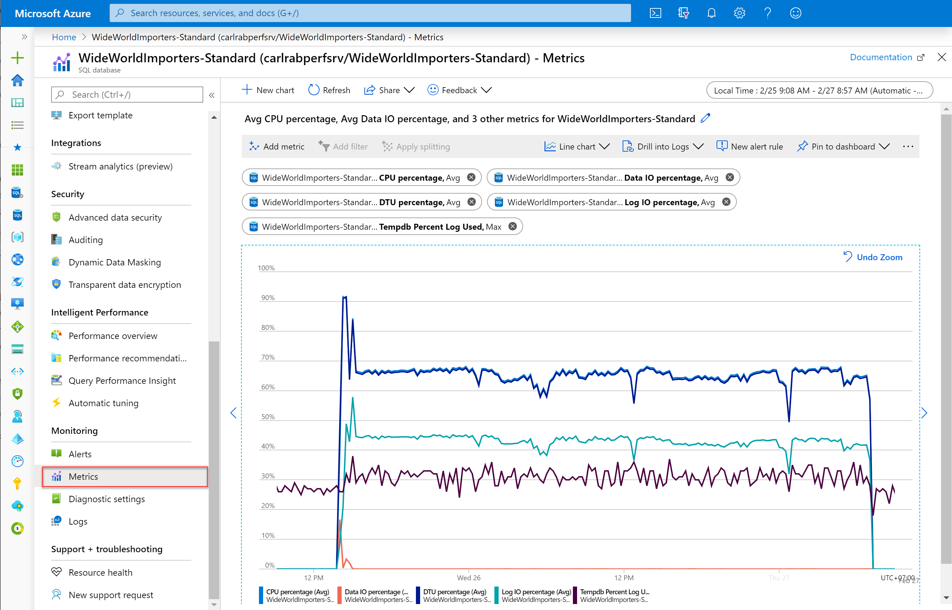

Slide 45
